Slide 1
{Customer Name}
Adobe Experience Manager as a Cloud Service – Deep Dive

Slide 2





Agenda
Drivers for Moving to the Cloud
Evolution of Adobe Experience Manager
Key benefits of AEM as a Cloud Service
Architecture: AEM as a Cloud Service
Deep Dive:
Always current
Modular, scalable and global
Performance resiliency
Secure by default
Transition to AEM as a Cloud Service

Slide 3

Companies leading the way in Customer Experience (CX) are
3x more likely
to have significantly exceeded their top business goals.

Slide 4

Technology infrastructure sets the pace for CX initiatives
80% of IT executive report that conflicts occur between marketing-related IT priorities and broader development or maintenance functions
Keeping on top of technology and innovation trends remain significant worry for many IT executives (35%)
Downtime and threat of security are among the top 3 infrastructure health challenges (44%)
2020 Digital Trends: IT in Focus
Adobe & Econsultancy’s
Digital Trends 10th Edition, 2019
Based on 1085 qualified survey responses

Slide 5



Inefficiencies and outdated infrastructure can lead to poor business results
Outdated CXM innovations
Long and costly upgrades and maintenance cycles
Slow to market with new experiences
Slower deployment cycle with pile-up of requests from marketing
Marketing Team
IT Teams
Performance issues and under-par experience for end consumers
Spending cycles in maintaining the desired uptime
Poor engagement /conversions,
low customer loyalty
Inefficient operations, high cost of ownership

Slide 6



Modernizing with a strong cloud foundation can help accelerate CX initiatives
Marketers / Content Authors
Site Admins & Developers
Business Leaders
Continuous access to the latest Experience Manager innovations
Accelerated time to market with engaging experiences
Less dependency on IT teams
Ensured high performance for end consumers irrespective of traffic peaks
No resourcing or planning needed for version upgrades
Minimal application maintenance needed
Faster performance & greater scale with a cloud deployment architecture
Easier to build new enhancements
Lower TCO
Faster speed & agility to support new business initiatives.
Simplification of IT stack with one vendor
IT teams aligned with company’s overall strategic and commercial initiatives

Slide 7





Cloud-hosting is not enough. Cloud-native is the future.
Version management
Slower innovation due to accumulated technical debt
Always current
with innovations without interruptions
Governance
IT resources stuck on regular application maintenance & support coordinating with multiple vendors
Auto-updated
with critical fixes with minimal interruptions. One vendor with high SLA commitments.
Performance
Planning infrastructure for uptick in traffic and storage
Auto-detects and auto-scales to ensure high performance
Resilience & Security
Designing for necessary backup systems to restore services
Self-healing architecture
and built-in geo redundancy with regular data backups

Slide 8
Evolution of Experience Manager

Slide 9
Evolution of Adobe Experience Manager
2017
Separate Content & Apps and Composite Repository
2018
Twelve factor and containerization
2019
Federated
services & Control system
The Journey
Multiple years of preparation and adjustments to allow for immutable deployments
Future
2020
Fully cloud-native AEM as Cloud Service
Analyse
Rollout & Measure
Plan & Refactor
Focus on keeping all the options to build and innovate with AEM as you know it

Slide 10

Adobe Experience Manager as a Cloud Service
Modern, purpose-built unified solution for experience management that provides cloud-native agility to accelerate time to value and is extensible to meet your unique business requirements.

Slide 11


AEM as a Cloud Service: Better way to run AEM in cloud
50%
Faster asset upload speed
225 unique daily users of the asset management system using 12TB of disk usage daily
2x higher asset users and asset downloads through the streamlined Asset Sharing Portal
Under Armour
50%
Faster code deployment
Weekly code updates compared to code pushes every two weeks.
Eliminated the need to spend in-house resources managing servers or planning upgrades, allow IT to focus on higher value technical tasks
Ping Identity

Slide 12
Key benefits: AEM as a Cloud Service

Slide 13




Key Benefits of AEM as a Cloud Service
Always current
New capabilities seamlessly validated and live instantly so that teams can focus on innovating instead of planning for version upgrades
Modular, scalable and global
Optimal performance for customers and employees based on autoscaling and microservices architecture
Performance resiliency
Redundancy and monitoring to provide mission-critical service level availability
Secure by default
All environments pre-configured to Adobe-backed security rules based on enterprise-tested best practices and security frameworks such as ISO 27001 and SOC-2

Slide 14
Key Benefits of AEM as a Cloud Service
Always current
Lower TCO with automated product updates
Agility with faster deployment cycles (CI/CD) and automated testing
Self-service provisioning
Modular, scalable and global
Ensured performance for both publish and author tier with auto-scaling
Architected for global scale with default CDN
Faster asset ingestion and renditions with dedicated microservice
Performance resiliency
High resilience with built-in geo redundancy
High reliability with self-healing infrastructure
Backup and recovery strategy
Secure by default
Enterprise-level isolation
Environments pre-configured with security rules
Authentication with IMS
Compliant with industry-recognized security standards

Slide 15
Architecture

Slide 16
Containerization
Per Environment
Shared Service
Containers
CDN Service
Orchestration Service
Content Repository Service
Replication Service
(Adobe Pipeline)
Publish Tier
AEM Sites
Nodes (Publish)
Dispatcher
Dispatcher
Publisher
Publisher
Nodes (Author)
CI/CD Service
Blobs (Shared)
Author Tier
AEM Sites/Assets
Author
Author
Author
Assets Compute Service
(Adobe I/O Runtime)
Identity Management Service
Maintenance
Job
Job
Testing Service
(Adobe I/O Runtime)

Slide 17





Adobe Experience Manager packaged in Containers
Allows for rollbacks to earlier versions
Allows for truly dynamic autoscaling with elastic storage
Consistent & reliable testing due to immutable nature of containers
Enables rolling updates to allow for minimal to no downtime
Automated container building & testing allows for fully automated CI/CD

Slide 18
Always current
Lower TCO: Continuous delivery model
Accelerate time to market: Continuous integration and delivery (CI/CD)
Self-service provisioning

Slide 19

Always current
Focus on innovating; not product upgrades or maintenance
Continuous innovations
Reduced maintenance
Capabilities and features released on monthly basis
Security updates and performance enhancements released on a regular basis
Continuous releases with no interruption of service

Slide 20
Lower Total Cost of Ownership
No product upgrades
Reduced regular maintenance tasks
Implementation
Implementation
Effort & Cost
Product upgrades
Effort & Cost
Maintenance releases
Customizations
Year 1
Year 2
Year 3
Year 4
Year 5
Year 1
Year 2
Year 3
Year 4
Year 5
TCO – Industry average
TCO – AEM as a Cloud Service

Slide 21




Safe and secure updates with backward compatibility
Note: The slide has an animation. Please play in presentation mode.
Rolling updates
Experience Manager updates delivered with minimal interruption of service
Easy rollback to previous versions possible
All updates with backward compatibility
Release validation pipeline
n1
n2
n1
n2
n1
n2

Slide 22




Release validation pipeline
for robust assessment and validation
Adobe Engineers
Module level validation
Pull Request assessment
End to end validation
Customer update assessment
Rollout
Release safe and marked public
Intelligent Customer Validator compare updates against previous
real-world deployment
Constant Feedback Loop

Slide 23

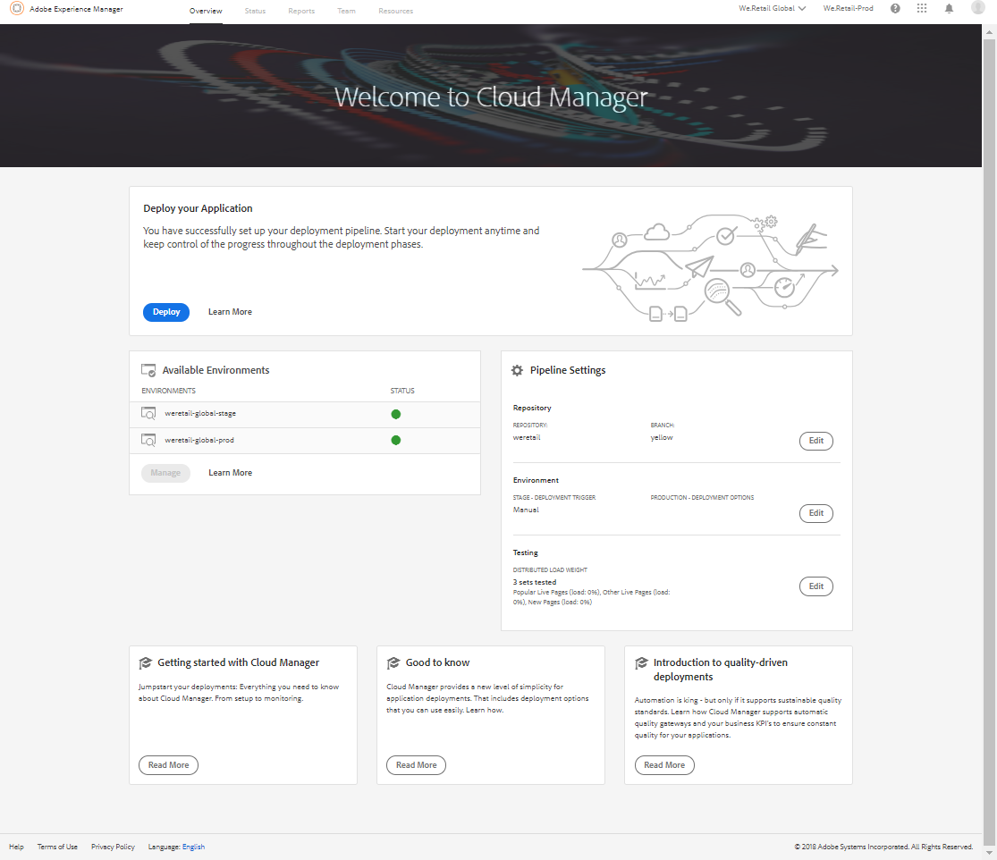

Accelerate time to market with purpose-built DevOps framework
Cloud Manager for Adobe Experience Manager
of code to accelerate time to market for deployment from months/weeks to days/hours.
Continuous integration and delivery
even outside of business hours for maximum flexibility and control.
Automatic, scheduled or manual deployment
based on best practices before pushing to production to minimize disruptions.
Code inspection, testing and security validation

Slide 24
Accelerate time to market: Continuous integration and delivery (CI/CD)
Per tenant immutable image
Stage deployment
Functional testing
Experience audit
for performance
Production deployment
Adobe release orchestration
Custom building
Baseline AEM release
1
2
3
4
5
Custom code
Custom code CI/CD
Non-Production Environment
Staging
Environment
Production
Environment

Slide 25
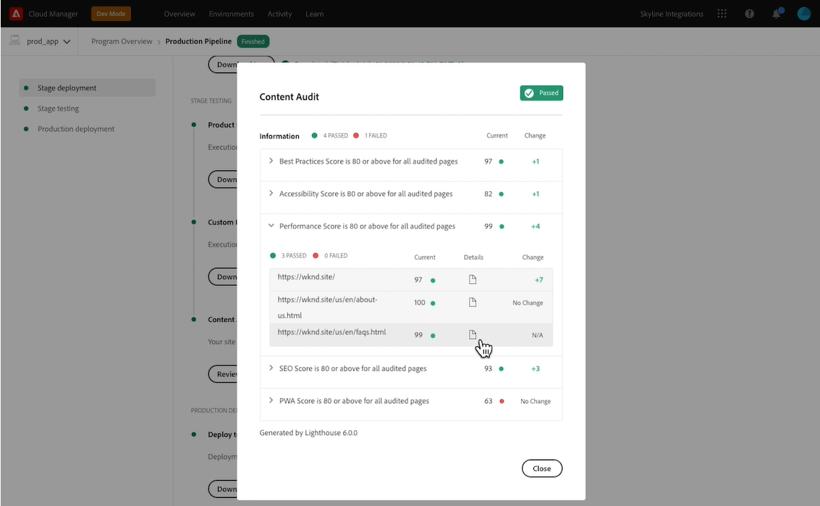
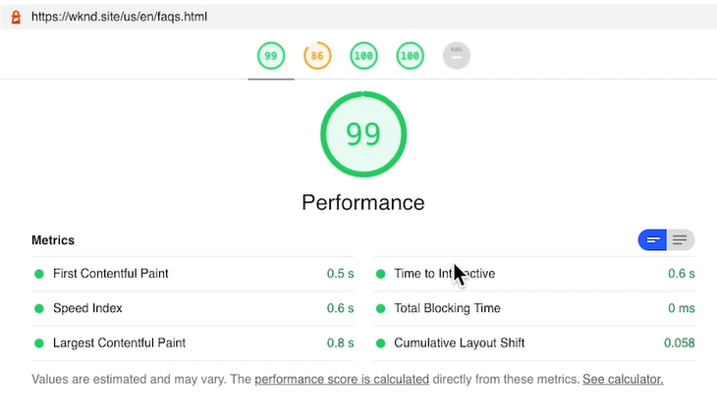
Experience Audit
Automatically validate content quality and performance prior to every update
2. Compare with benchmarks
3. Guidance to improve quality
1. Measure site quality and performance
Updates to code/content
Improve over time
Experience audit
Performance | Measure and accelerate page load speed​s
Accessibility | Optimize navigation and content for disabled visitors​
SEO | Ensure search engines understand and index your site
Best practices | Measure and improve overall code health of the site​
Progressive Web App | Validate and optimize site for next gen frameworks​

Slide 26
Extend existing DevOps processes
Cloud Manager API complements existing systems and DevOps processes
HTTP access to programs & pipelines
Self-service management of service accounts & event handlers
Role-based access control for service accounts
Webhook notifications for pipeline state changes
Complete reference and tutorial documentation

Slide 27


Cloud Manager API Use Cases
Running external tests
Starting Pipeline
Cloud Manager
Webhook
On-Premise CI Engine
Cloud Manager
On-Premise CI Engine
Notifying external systems
Cloud Manager
Webhook
Notification Channels

Slide 28
Rapidly promote code changes and eliminate manual processes
Easily set-up, configure, and kickoff CI/CD pipeline and reduce Mean Time to Resolution
Set-up production and non-production pipelines to test and release code updates
Set roles and permissions for different team members

Slide 29

Gain flexibility and control with choice of deployment options
Increasing degree of automation
Automatic
Scheduled
Fully automated deployment for maximum controls
Manual
Gives flexibility to conduct deployment during specified timeframe
Provides maximum control and best suited for new users

Slide 30
Modular, scalable and global
Ensured performance for both publish and author tier with auto-scaling
Architected for global scale with default CDN
Faster asset ingestion and renditions with dedicated microservice

Slide 31








Auto-scaling for author and publish
Automatically detects the need for increased capacity and scales dynamically
CDN
Vertical Scaling
Adds additional memory or processing to current systems
Developer
Non-production environments (Dev, UAT…)
Staging and Production environments
Publish
farm
Author cluster
Horizontal Scaling
Adds as many new nodes as needed for high performance
Author

Slide 32


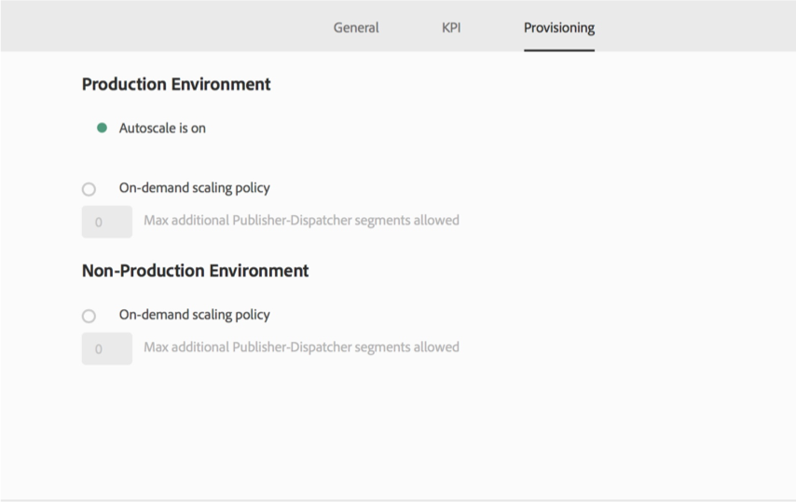
Autoscaling in Action
P
P
P
P
P
P
A
A
A
A
A
Existing Author or Publish Tier
Load Spike
Autoscaling Event Triggered
New Replicas added via Container Orchestration

Slide 33
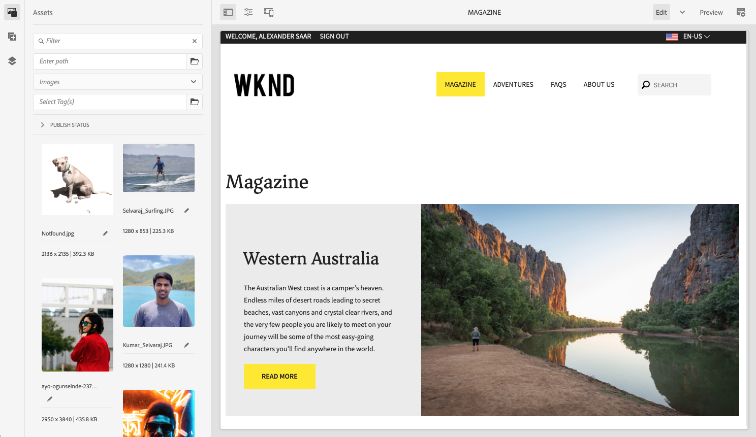
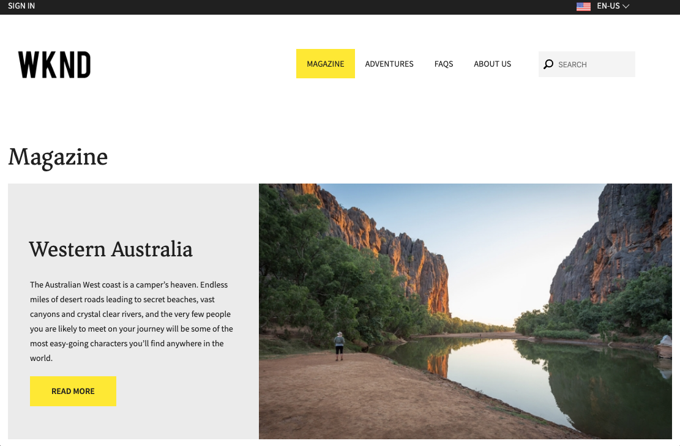

EXPERIENCE CONSUMERS
EXPERIENCE CREATORS
Content Distribution Network
Architected for global scale
Content Delivery Network
EXPERIENCE CONSUMERS
EXPERIENCE CONSUMERS

Slide 34
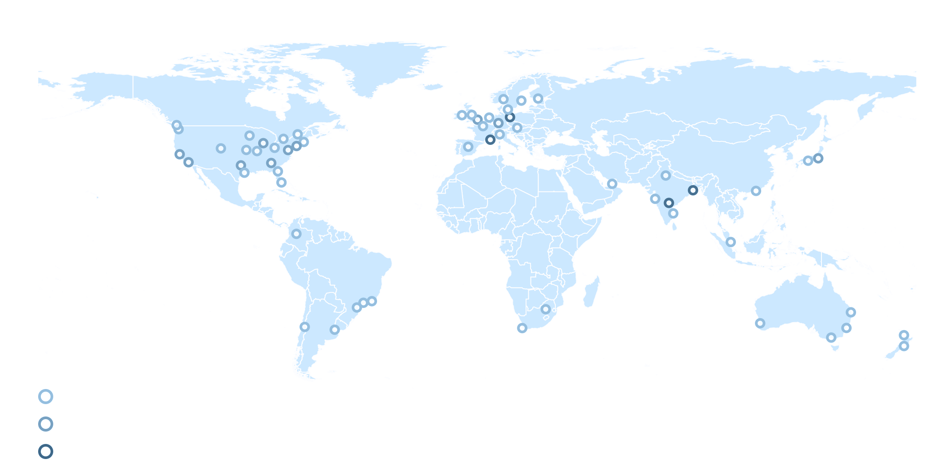
Global infrastructure and scale
Worldwide POP locations
Canada
London
Amsterdam
Frankfurt
US west
US east
Japan
Singapore
Sydney
Core sites
Existing POP location
Multiple POP locations
Planned POP locations
* showing locations as of Mar 31st, 2020

Slide 35




Scalable asset processing & ingestion
Initiate upload
On-prem
1. Asset upload
(direct binary upload)
Experience Manager
Bandwidth shared with other requests
Cloud Service
Binary Cloud Storage
Experience Manager
Bandwidth dedicated to Asset Ingestion

Slide 36


Scalable asset processing & ingestion
Initiate upload
1. Asset upload
(direct binary upload)
AEM
Deployment
DAM Author
Supporting globally distributed users
With Edge Network
Without Edge Network

Slide 37

Scalable asset processing & ingestion
Initiate upload
1. Asset upload
(direct binary upload)
AEM Assets as Cloud Service
Adobe I/O API Gateway
Adobe I/O Events
1. Asset processing
(asset microservices)
Asset Microservices
PDF Worker
Photoshop Worker
Custom Worker
Binary Cloud
Storage
Adobe I/O Runtime
Adobe Sensei
3rd party
Service

Slide 38
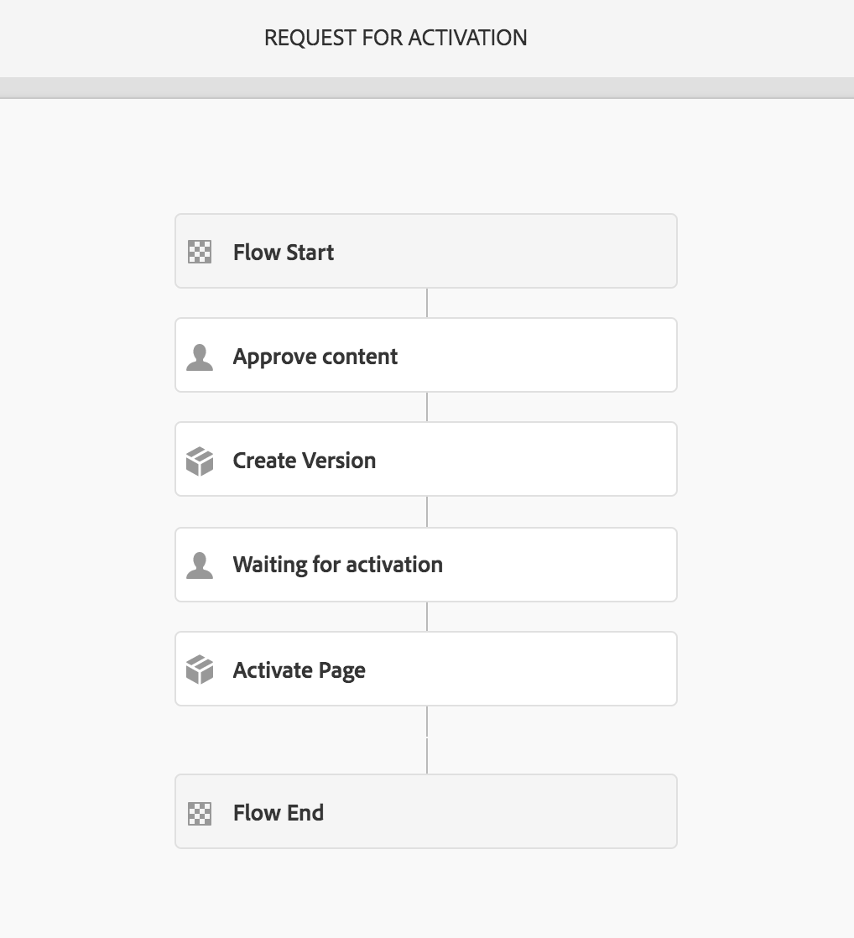
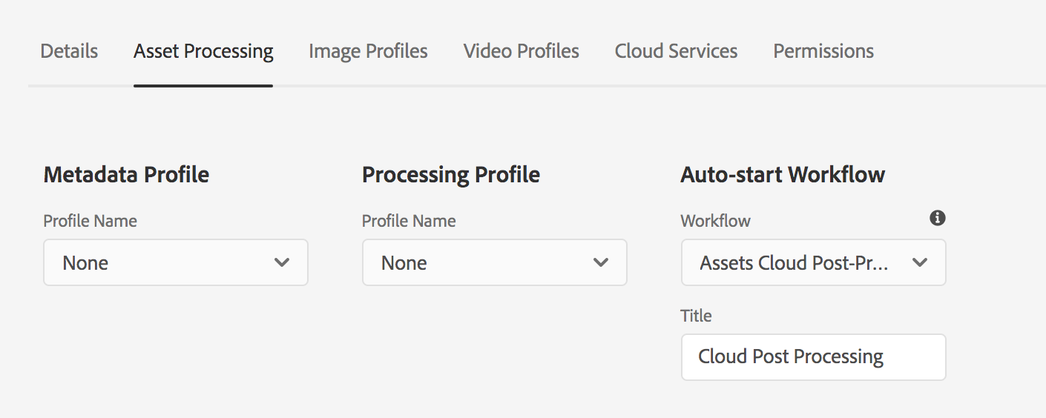
Scalable asset processing & ingestion
Initiate upload
1. Asset upload
(direct binary upload)
Custom Business Logic in Workflows
Workflows can be started automatically after the Asset Processing through a simple configuration in the UI
1. Asset processing
(asset microservices)
OOTB Renditions / metadata ready
3. Post-processing Workflow
(optional)

Slide 39
Scalable asset ingestion, processing & downloads
Initiate upload
1. Asset upload
(direct binary upload)
2-10X
Faster ingestion speed
(specially for larger, 1+ GB files)
1. Asset processing
(asset microservices)
AUTOSCALING ELASTICITY
to handle increases in BOTH traffic and processing demand
OOTB Renditions / metadata ready
3. Post-processing Workflow
(optional)
CUSTOM BUSINESS LOGIC
AI-driven workflows custom tailored to specific use cases
4. Asset Download
1.5-3X
Faster download speeds
Asset ready

Slide 40
Performance resiliency
High resilience with built-in geo redundancy
High reliability with self-healing infrastructure
Backup and recovery strategy

Slide 41



Designed to withstand disruptions
Geo redundancy
East US
West US
Geo-replicated
Complete restore of backup
Segment & Blob store
Author tier node store
Pipeline clusters
Segment & Blob store
Author tier node store
Pipeline clusters

Slide 42


Designed for high reliability
Note: The slide has an animation. Please play in presentation mode.
Self-healing infrastructure
Orchestration engine
Orchestration engine
Continual monitoring of health of pods
Pod 1
Pod 2
Pod 3
New pod
Pod 2
Pod 3
No single point of failure
Automatic recovery

Slide 43


Resiliency
Multiple Scenario Plans
Adobe-defined recovery scenarios optimized to effectively address arising problems
Regular Testing
Regular disaster recovery testing ensures effectiveness of recovery processes
Pro-active monitoring
Equipped with pro-active readiness and liveliness health checks

Slide 44
Backup & Recovery Strategy
Highly frequent
data back-ups
Fast and
in time recovery
In-region
protection
Daily snapshots stored up to 7 days
System restored to any point
in last 24 hours
Built-in redundancy with
geo-replication of data snapshots

Slide 45
Secure by default
Enterprise-level isolation
Environments pre-configured with security rules
Authentication with IMS
Compliant with industry-recognized security standards

Slide 46
Adobe’s Security Strategy
Proactive
Reactive
Harden systems & mitigate vulnerabilities
Identify threats & quickly contain risks
Defense in depth
React efficiently
Transparent communication on what we are doing

Slide 47


Security Features of Cloud Service
Annual penetration testing
Intrusion detection
Advanced firewall systems
Virus protection
Industry-recognized certification:
ISO 27001, SOC-2, GLBA-ready
Weekly Database scans
24x7x365 proactive
service monitoring
Monthly Vulnerability Scan Review
Authenticated user identity management
Data isolation and
encryption

Slide 48



AEM as Cloud Service Security Architecture
Isolated namespace, networking policies, computing and storage
Tenant and node level isolation
CDN
CDN
Firewall
Cluster Load Balance
Adobe container management platform provides core security functionality on top of applications
Tenant Cluster
Network Policies and Ingress Routes
Data encryption
Per Tenant Environment Namespace
TLS encryption for data in transit
FIPS-compliant cypto-library
System-wide encryption for AEM content repository
Author
Author
Dispatcher
Dispatcher
Author Service
Publisher
Publisher
Additional layer of security and compliance
Publish Service

Slide 49
AEM as Cloud Service: Network architecture
Segregating data
content segmentation in different DBs, with connection via AEM only
Firewalls (SNR and LB) with outbound limitations to HTTPS, NAT, fully redundant.
Service Monitoring, 24x7x365 via NOC and SLI/SLO management
Secure Management, with dedicated network connections over TLS, 2FI.
Protection against DDOS on L3, L4, L7 protections.

Slide 50
Transition to AEM as a Cloud Service

Slide 51
 | ON PREMISE | AEM as a CLOUD SERVICE | AEM with MANAGED SERVICES
Adobe’s enterprise software | Yes | Yes | Yes
Architecture | Hosted | Containerized | VM-based
Product upgrades | Manual | Continuous release model | Adobe-managed
Secure & dedicated environment | X | Yes | Yes
Default CDN optimized for AEM | X | Default CDN or BYO–CDN | BYO-CDN
Application (AEM) level SLA | X | 99.9 | 99.5, 99.5 HR, 99.9, 99.95, 99.99
Adobe management & support | X | Premier support | Dedicated or pooled CSE
Adobe IP-enabled code testing & deployment (CI/CD) | X | Cloud Manager | Cloud Manager
Adobe-managed capacity elasticity and auto-scale | X | Author & Publish tier auto-scaling | Publish tier auto-scaling
24/7 AEM monitoring, event response and disaster recovery | X | Yes | Yes
Security (ISO-27001, SOC-2) | X | ISO-27001, SOC-2 GLBA-ready | ISO-27001, SOC-2 HIPAA,* FedRAMP*, GLBA-ready*, FERPA*
Day to day AEM maintenance & encrypted backups | X | Yes | Yes
* Certifications offered as part of Enhanced Security add-on

Slide 52
Customer Best Practices for Planning a Cloud Service Transition
Build Cloud Service into company strategy.
Understand key stakeholders. Identify a core team of cloud leaders to enable existing business users and support staff.
Plan ahead—work cloud transition into your budget and strategy ahead of contract renewals.
Anticipate outcomes and prepare your organization.

